Slide 1
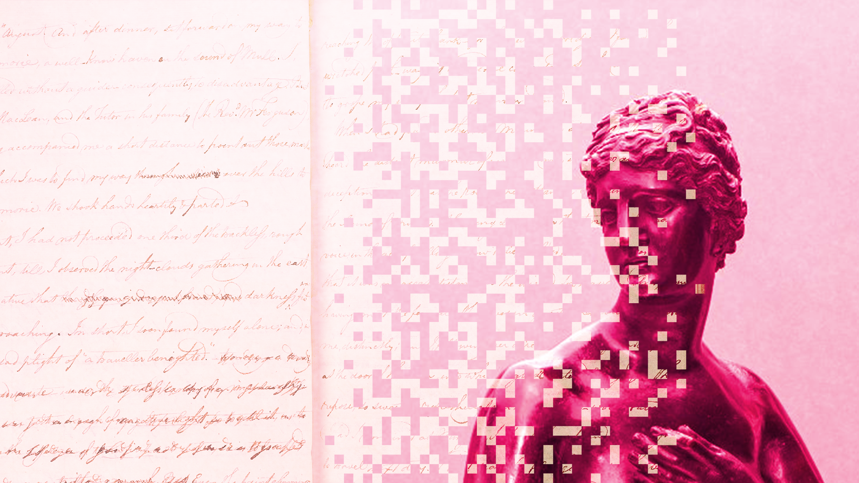



Data
Culture
society
@edCDCS
Notes:
MT

Slide 2


Working
with OCR
2 February 2023
@edCDCS
Notes:
MT

Slide 3


Overview
Day 1 (2 Feb.)
Introduction to OCR: history, techniques, problems
Applying OCR methods in research
Hands-on activities
Day 2 (6 Feb.)
Review of programming basics
Introduction to OCR packages
Working with OCR in Python & R
www.cdcs.ed.ac.uk

Slide 4
Discussion
Are you familiar with OCR? What do you know already, and what do you hope to learn?
Summarize your experience with digital research methods. What tools have you used/do you plan to use in your work, and why?
www.cdcs.ed.ac.uk

Slide 5
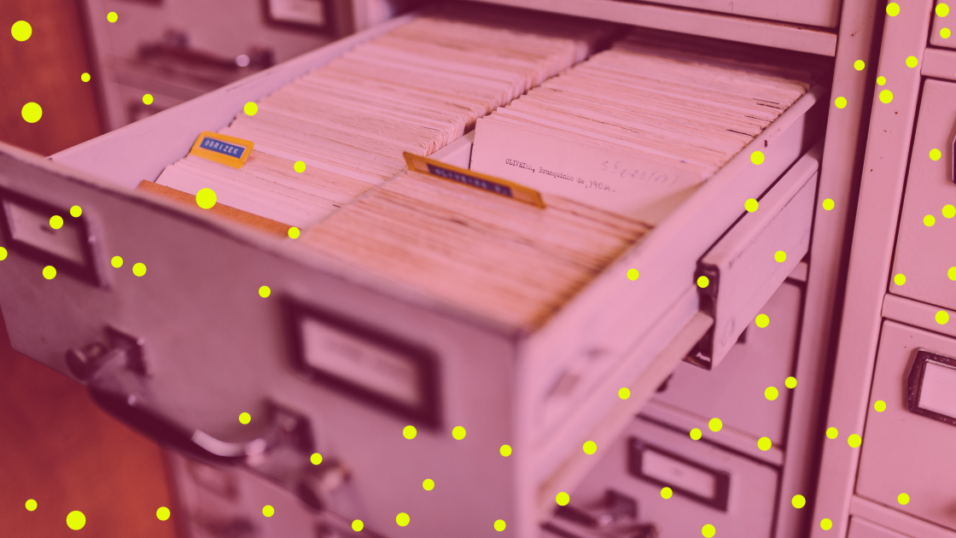
What Is OCR?
Optical Character Recognition
Transforms written, typed, or printed text into encoded text
Creates machine-readable documents that can be searched, edited, and analysed computationally
Improves accessibility: compatible with text-to-speak technology
Multi-step process:
Select image or text to be scanned
Scan image with OCR software
Clean and save the OCR-produced document
www.cdcs.ed.ac.uk
Notes:
MT

Slide 6
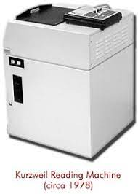
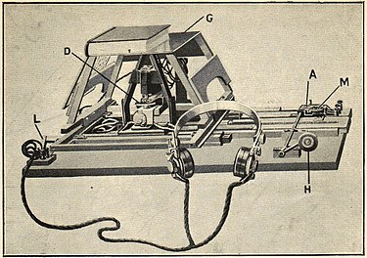
OCR Timeline: A Brief History
Early Foundations
1914: Emanuel Goldberg invents a machine that converts text into telegraph code; Edmund Fournier d’Albe invents the Optophone, which converts text to audio tones matched with letters
1931: Goldberg invents the “Statistical Machine,” which searches archives through optical code recognition
Mid-Century Machinery
1974: Ray Kurzweil develops the “Reading Machine,” an early form of OCR technology compatible with text-
to-speech software
1976: Kurzweil sells to Xerox
The Internet Era
1990s-00s: OCR goes mainstream; improved accuracy; mass digitization projects
00s-present: increased accessibility and accuracy
www.cdcs.ed.ac.uk
Notes:
MT

Slide 7
Activity & Discussion
Identify a dataset that you might use in your research. (You can find one online or use one you already have.)
Write a workflow of the steps you will take to obtain encoded text from your dataset.
Consider any problems, errors, or other obstacles you might encounter during this process. How might you address them?
Share your dataset, workflow, and plan with your small group.
www.cdcs.ed.ac.uk

Slide 8

Accuracy is never 100%
Patches can correct errors, but only if they are predictable
Missed column/margin formatting can scramble or cut off text
Age of and damage to scanned material leads to errors
Newer OCR is faster and more accurate than older software
Human error
Problems & Errors
www.cdcs.ed.ac.uk
Notes:
MT

Slide 9
Manually: Read through the text and manually change what needs to be changed
Regex: Programmatically fix repetitive errors
Patches and Machine Learning techniques: Certain software have an embedded
How to Clean your OCR File
www.cdcs.ed.ac.uk
Notes:
MT

Slide 10
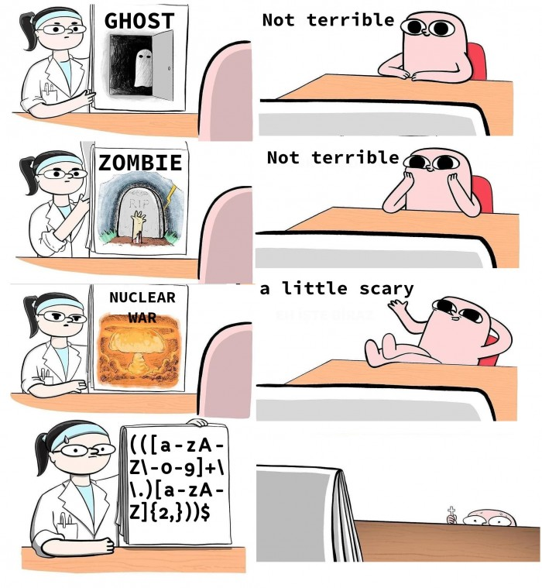
Regex
Concept used in many different programming environments for pattern matching.
Powerful tool to find, manage, and transform data and files.
Use a sequence of characters to define a search to match strings
Match on types of characters (e.g. ‘upper case letters’, ‘digits’, ‘spaces’, etc.).
Match patterns that repeat any number of times.
https://devhumor.com/media/the-nightmare
www.cdcs.ed.ac.uk
Notes:
MT

Slide 11
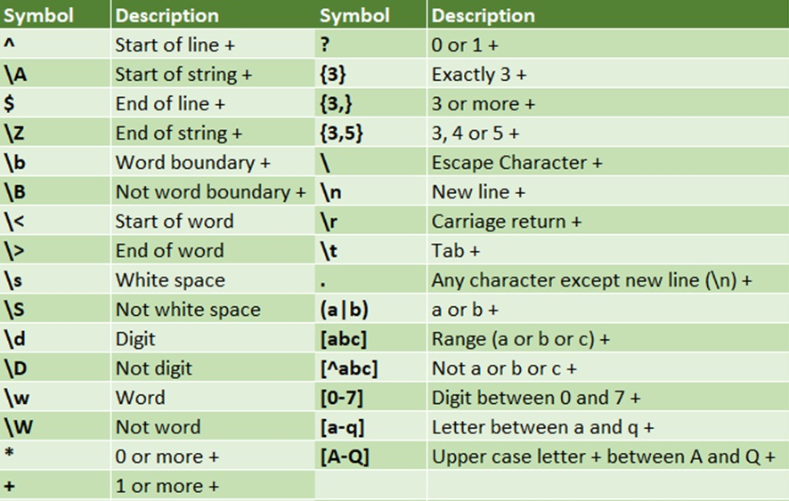
Regex
https://programminghistorian.org/en/lessons/cleaning-ocrd-text-with-regular-expressions
https://programminghistorian.org/en/lessons/understanding-regular-expressions
https://librarycarpentry.org/lc-data-intro/01-regular-expressions/
www.cdcs.ed.ac.uk
Notes:
MT

Slide 12
Activity & Discussion
Identify a pdf you want to use
Try the following out of the box options
https://tools.pdf24.org/en/ocr-pdf
https://www.onlineocr.net/
https://www.sodapdf.com/ocr-pdf/
https://www.sejda.com/ocr-pdf
https://ocr.space/
https://avepdf.com/pdf-ocr
Compare the results
Which one performed better?
Which are the limitations of these options?
www.cdcs.ed.ac.uk

Slide 13
OCR In the Wild: Real-World Examples
Depositing a check on a mobile banking app
Using the airport’s e-Passport Gates
Translating text with language recognition
Searching a digital database of historical public records
Digitizing physical archives and making them accessible online
Creating a dataset of physical books for text mining research
Adding machine-created metadata to digital collections
www.cdcs.ed.ac.uk
Notes:
MT

Slide 14
Tesseract
Optical character recognition engine for various operating systems
Developed in the '80s; available open-source since 2005
One of the most accurate open-source OCR engines available
Originally just English, but more and more languages have been added
Can run from command line interface or embedded in main coding languages (R & Python)
www.cdcs.ed.ac.uk
Notes:
MT

Slide 15
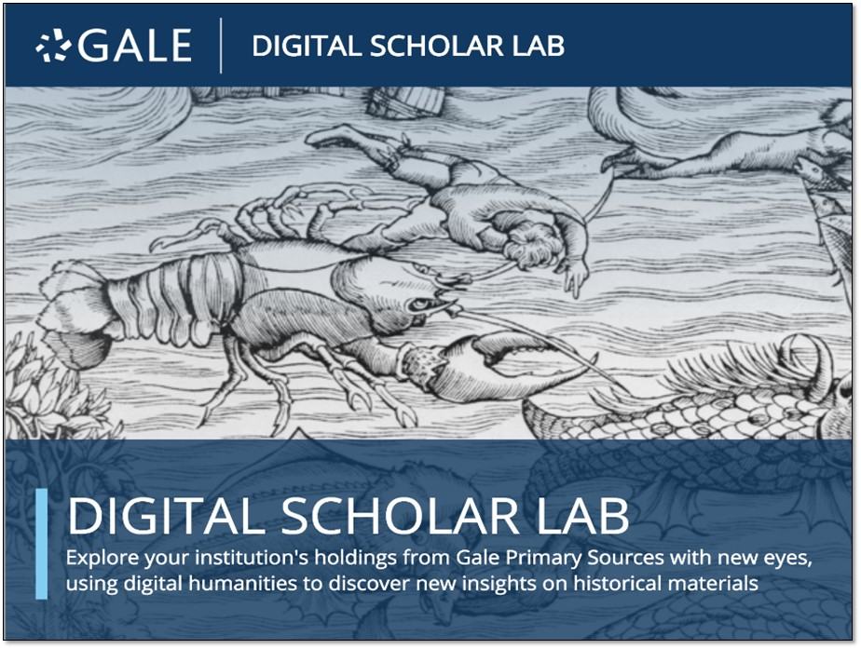
Digital Scholar Lab
www.cdcs.ed.ac.uk
Notes:
LO

